Slide 1
Intelligence by the Kilowatthour
Max Welling
Qualcomm Technologies
University of Amsterdam (UvA)
Canadian Institute For Advanced Research (CIFAR)

Slide 2
Prologue Introduction & Motivation

Slide 3
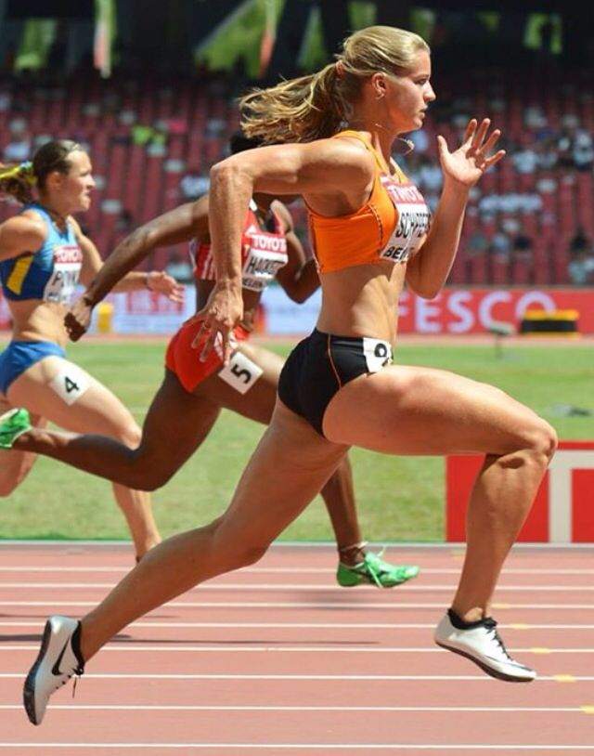
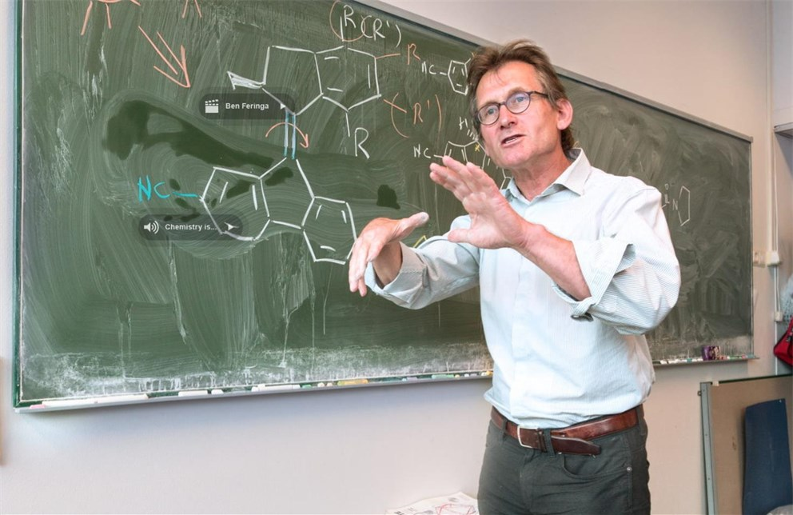
F = E - H
Daphne Schippers:
2015 & 2017 world champion 200 meters
Ben Feringa:
Nobel Prize Chemistry 2016

Slide 4
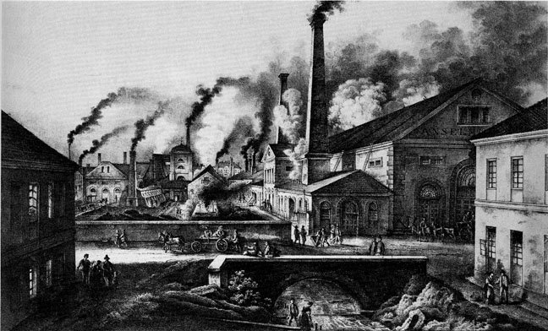
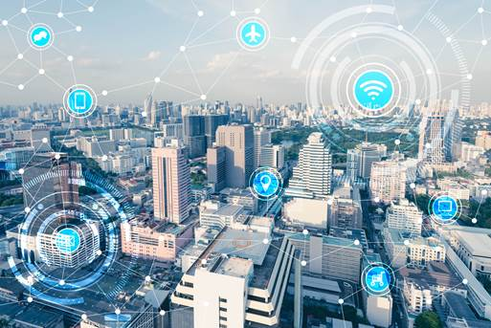
Free Energy = Energy - Entropy
Ability to perform physical work
Level of organization, information of a system
Industrial Revolution: ±1820
Information Revolution: ±1940

Slide 5
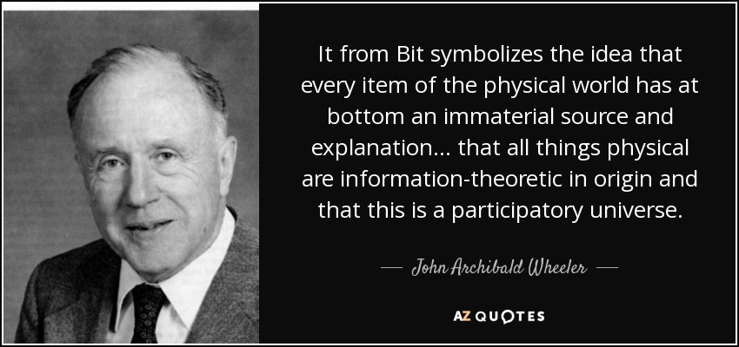
“It From Bit”

Slide 6
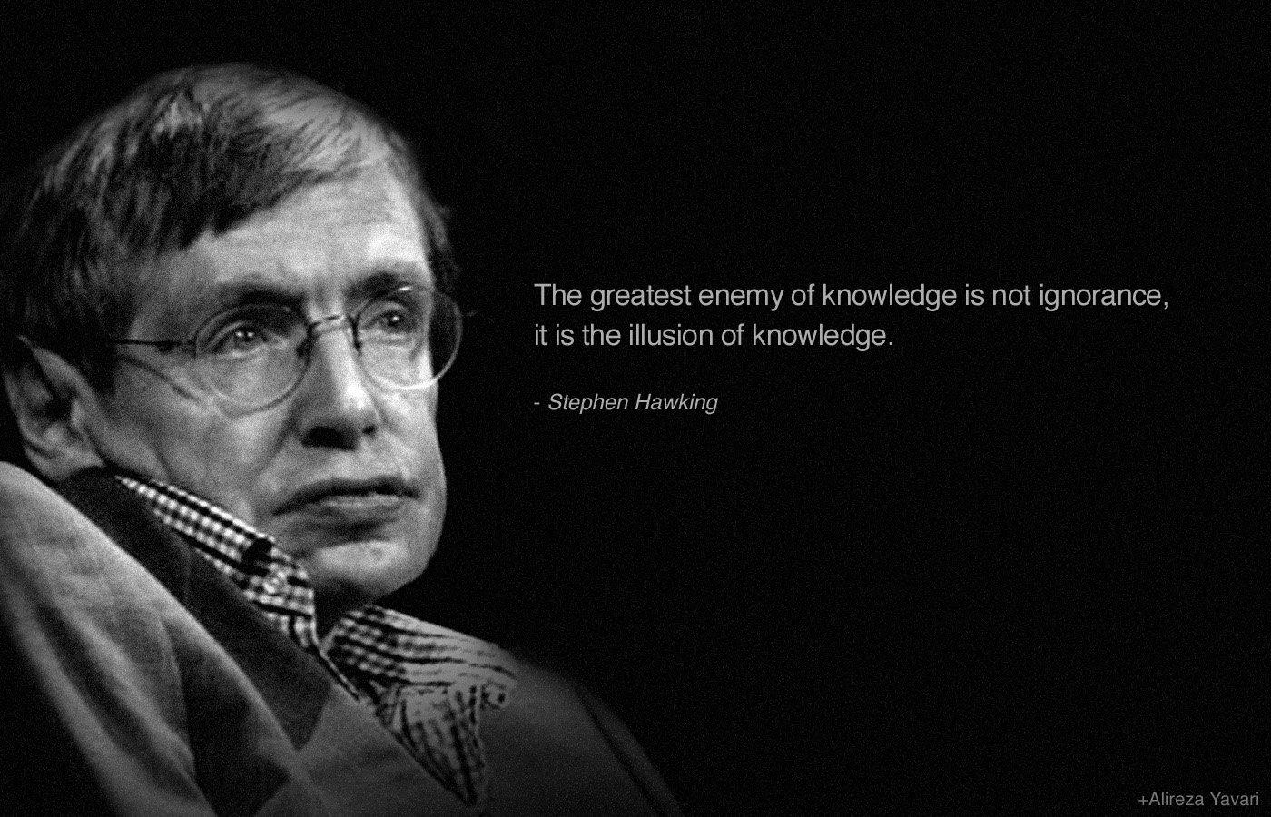
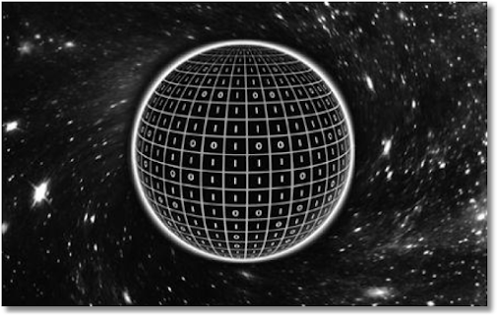
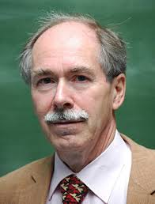
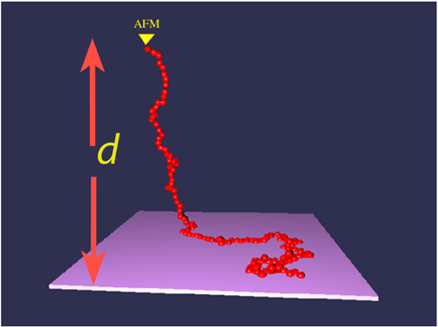
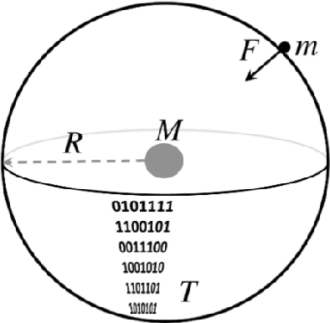
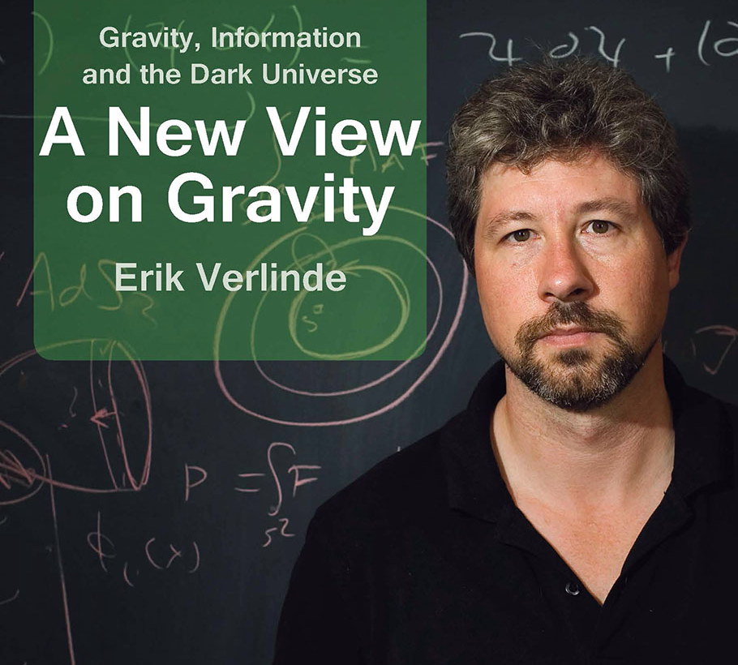
Entropic Forces and Gravity
Stephen Hawking
Black holes are thermodynamic objects, with an information content proportional to its area (the holographic principle)
Gerard ‘t Hooft
Gravity as an entropic force.
Erik Verlinde

Slide 7
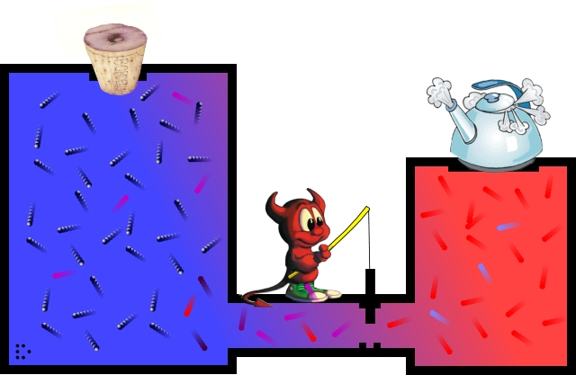
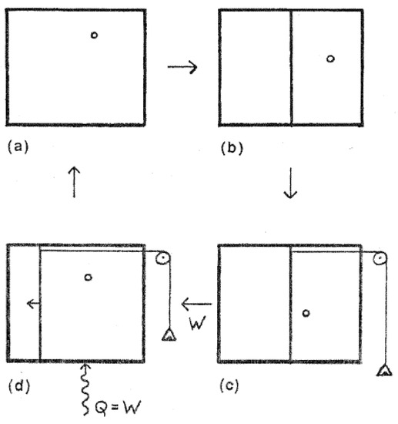
Free Energy: from physics to informatics
Second law of thermodynamics:
Entropy is the part of the free energy that cannot be converted into work
Maxwell’s demon
Szilard’s one molecule engine

Slide 8
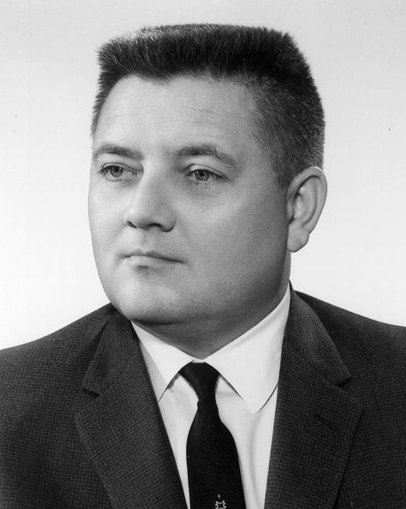
E.T. Jaynes
The free energy is a subjective quantity
Entropy is a degree of ignorance about the microscopic degrees of freedom of a system
Landauer: Computer memory of the microscopic state information needs to be overwritten which increases entropy and costs energy.

Slide 9
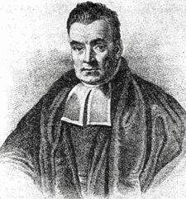
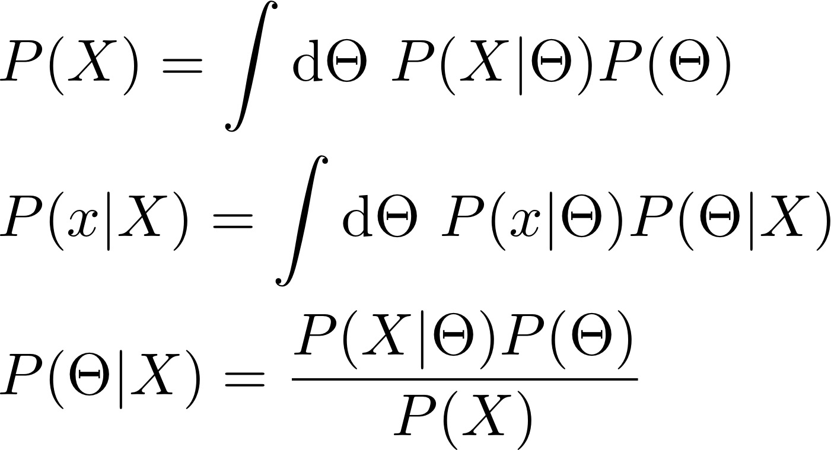
Bayes

Slide 10
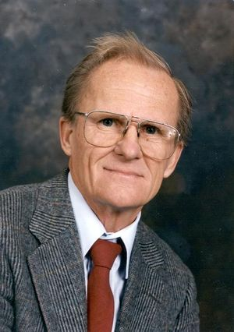
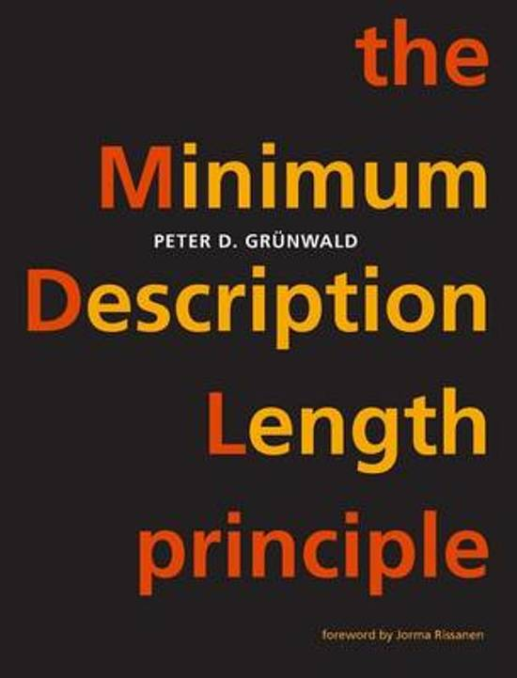
Rissanen
Rissanen, J. (1978). "Modeling by shortest data description"
Bits required to encode data hypothesis
Bits required to encode the hypothesis
Complex models require more bits to encode, which only pays off if N is large.

Slide 11
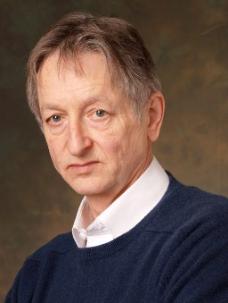
Hinton
Hinton & Van Camp, 1993, “Keeping Neural Networks Simple by Minimizing the Description Length of the Weights”
Neal & Hinton, 1998 “A view of the EM algorithm that justifies incremental, sparse, and other variants”
- Free Energy = - Energy + Entropy

Slide 12
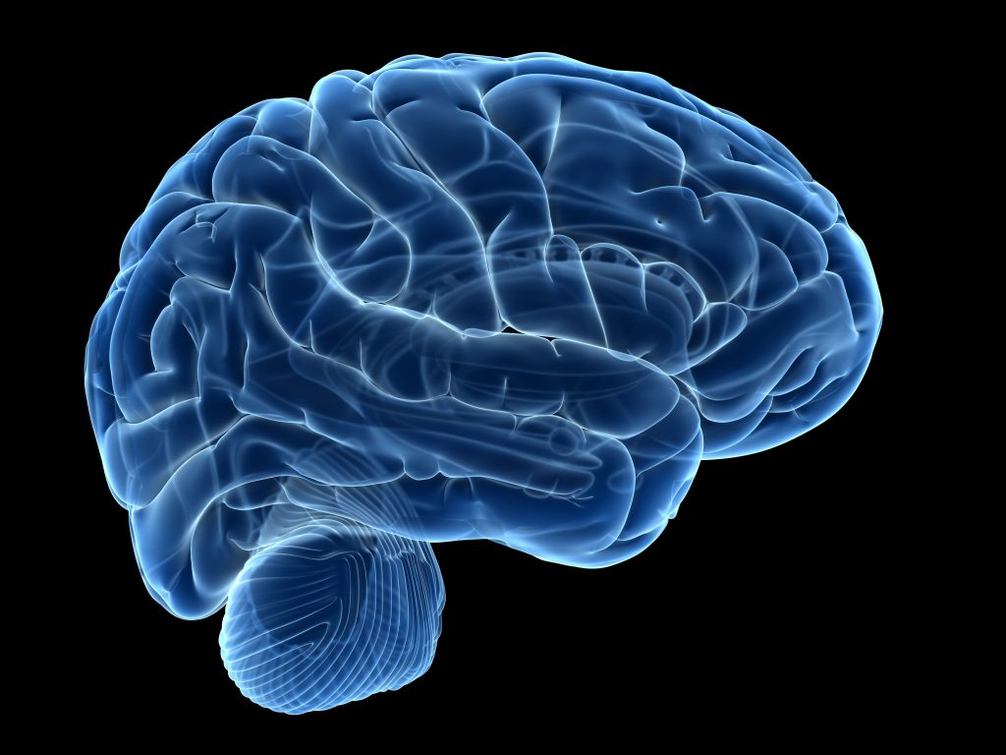
Summary
Entropy can improve computational efficiency ?
Helmholtz:
F=E-H
Physics
Hinton:
Variational Bayes
Jaynes:
Entropy is ignorance
Rissanen:
MDL
Modeling

Slide 13
Large Scale Approximate Bayesian Learning: MCMC & Variational Bayes

Slide 14
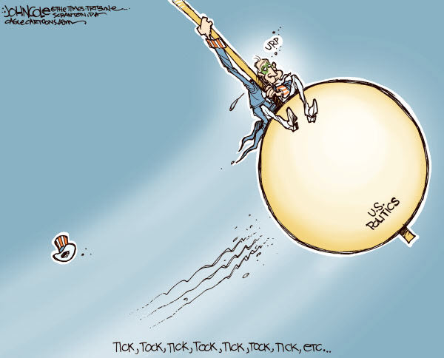
Variational Bayes versus MCMC
Variational Bayes
MCMC

Slide 15
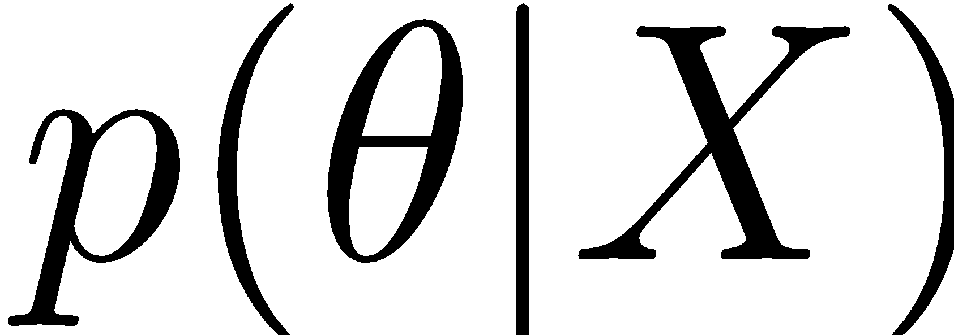
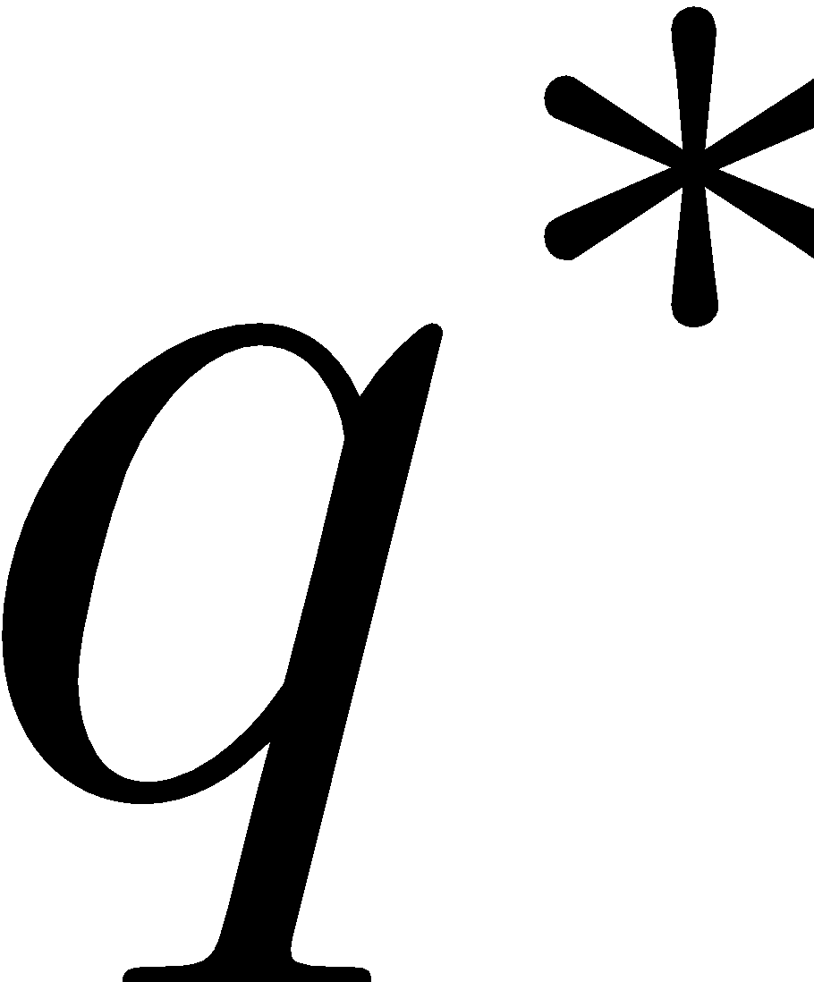
Bayesian Posterior Inference
Variational Inference
Sampling
Variational Family Q
All probability distributions
Deterministic
Biased
Local minima
Easy to assess convergence
Stochastic (sample error)
Unbiased
Hard to mix between modes
Hard to assess convergence
Notes:
Properties – Variational Inference is inherently biased, MCMC is unbiased given infinite sampling time, etc.
Main Latex Equations:
q^* = \min_{q \in Q} \text{KL} [ q(\theta) || p(\theta| X)]
\mathbb{E}_{p(\theta|X)}[ f(\theta) ] \approx \frac{1}{T} \sum_{t=1}^{T} f(\theta_t) \\\text{~where~} \theta_t \sim p(\theta|X)

Slide 16
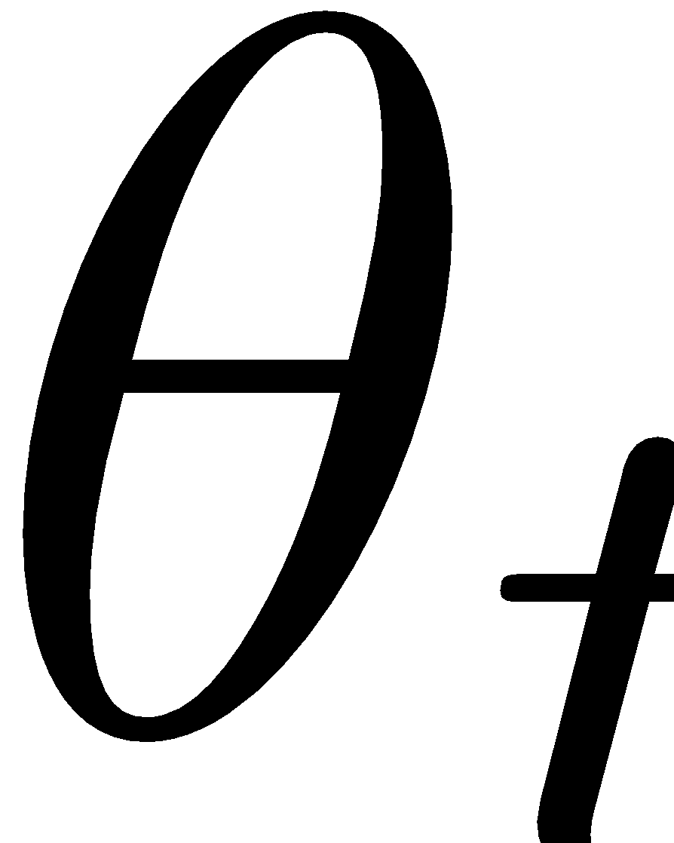
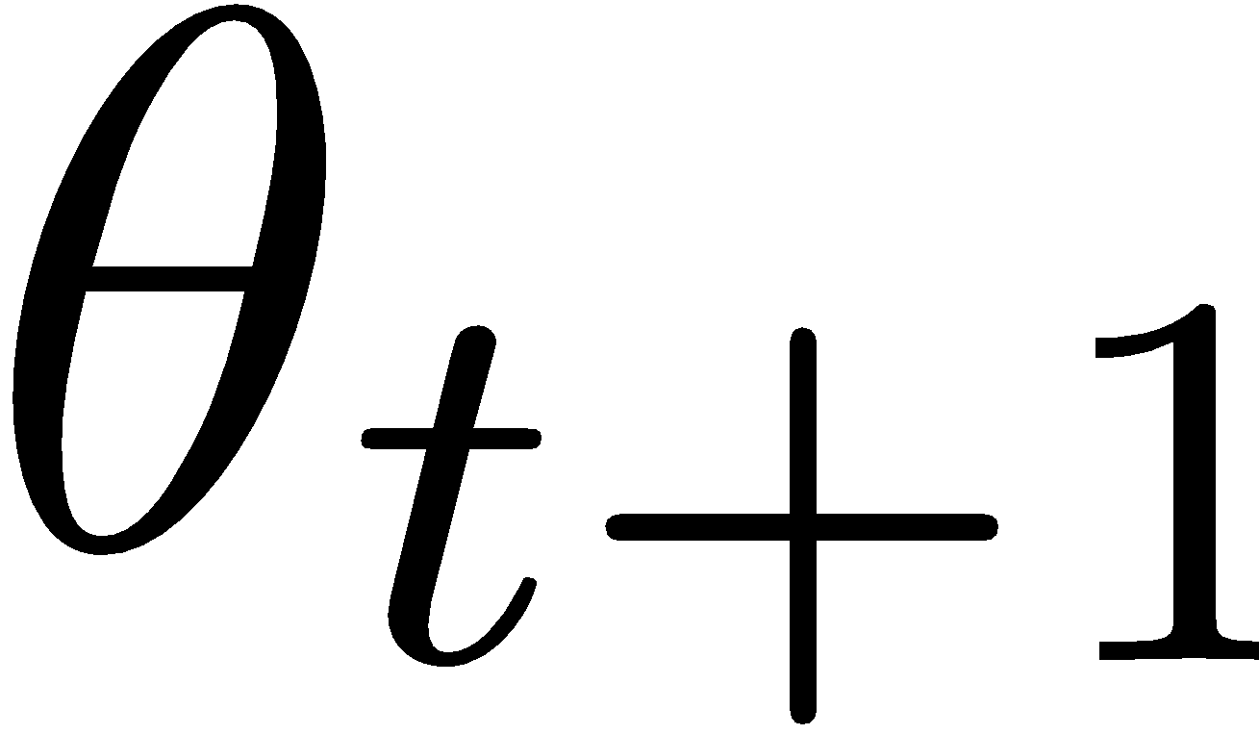
MCMC
. . .
. . .
Burn-in ( Throw away)
Samples from S₀
Notes:
Is there too much information on this slide?
Latex:
Given target distribution $S_0$, design transitions s.t. $p_t(\theta_t) \to S_0$ as $t \to \infty$

Slide 17
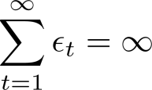
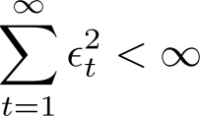
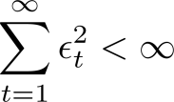
Stochastic Gradient Langevin Dynamics
W. & Teh. "Bayesian learning via stochastic gradient Langevin dynamics."
Gradient Ascent
Langevin Dynamics
↓
Metropolis-Hastings Accept Step
Stochastic Gradient Ascent
Stochastic Gradient Langevin Dynamics
e.g.
Metropolis-Hastings Accept Step

Slide 18
Stochastic Gradient MCMC
Q
x
x
x
x
Low Variance
( Fast )
High Variance
( Slow )
x
x
x
x
x
x
x
x
x
x
x
x
x
x
x
x
x
x
x
x
x
x
P
x
x
x
x
High Bias
Low Bias
x
P
x
x
x
Decreasing ϵ
Notes:
\text{Use samples from~} \mathcal{S}_\epsilon \text{~(instead of~} \mathcal{S}_0 \text{)} \text{~to compute~} \langle f \rangle_{\mathcal{S}_0}

Slide 19
Variational Bayesian Learning
Variational Family Q
All probability distributions
(“reparameterization trick”, Kingma & W. 2013)

Slide 20
Energy Efficient Deep Learning

Slide 21
10¹⁴
Deep neural networks are energy hungry and growing fast
2025: N = 100T = 10¹⁴
10¹²
2017: Extremely large neural networks (N = 137B)
10¹⁰
2013: Google/Y!
(N=+/- 1B)
10⁸
AI is being powered by the explosive growth of deep neural networks
Energy consumption
2009: Hinton’s Deep Belief Net (+/- N=10M)
10⁶
10⁴
1988: NetTalk
(+/- N=20K)
10²
1943: First NN (+/- N=10)
10⁰
1940
1950
1960
1970
1980
1990
2000
2010
2020
2030
2025
Will we have reached the capacity of the human brain?
Energy efficiency of a brain is 100x better than current hardware
Notes:
AI has brought tremendous new capabilities, but at an exponentially increasing energy concumption cost. We are seeing significant, but small, improvements in accuracy for very large increases in energy consumption.
The graph shows how deep neural networks are energy hungry and growing quickly. At our current trajectory, a neural network in 2025 will have 100 trillion weight parameters, which is similar to the capacity of the human brain, or at least the number of synapses in the brain.
Taking inspiration from human biology, the energy efficiency of a brain is 100x better than current hardware, so we know there are opportunities to do better in digital hardware.

Slide 22
Value created by AI must exceed the cost to run the service
Economic feasibility per transaction may require cost as low as a micro-dollar (1/10,000th of a cent)
Broad economic viability requires energy efficient AI
Notes:
The large computation and energy cost of deep neural networks leads to two challenges: one of which we like to call the AI economic ceiling.
You can think of it as the value created by AI must exceed the energy cost to run the service (which is logical)
To put this in perspective, the economic feasibility of AI per transaction may require cost as low as a micro dollar (1/10,000th of a cent ). Some examples of this would be:
Personalized advertisements and recommendations. The limit a social network can spend on ranking your posts, providing a personalized advertisement, or a recommendation of what else you might like to buy is measured in micro-dollars (Google, Facebook, Twitter, Amazon)
Smart security monitoring based on image and sound recognition – these can be 24/7 use cases
And for large-scale situations smart cities and factories, the efficiencies brought by AI must be worth the cost.
The point is that broad economic viability requires energy efficient AI

Slide 23
The AI power and thermal ceiling
The challenge of AI workloads
Constrained mobile environment
Very compute intensive
Complex concurrencies
Real-time
Always-on
Must be thermally efficient for sleek, ultra-light designs
Requires long battery life for all-day use
Storage/memory bandwidth limitations
Notes:
The second challenge is what we like to refer to as the AI power and thermal ceiling.
To make our vision of intelligent devices possible, we also knew that deep learning-based solutions will need to run on the device — whether a smartphone, car, robot, drone, machine, or other thing
Power and thermal efficiency are essential for on-device AI, but it is a big challenge since the AI workloads are compute intensive and must work in a power- and thermally-constrained environment depending on the form factor.
The AI workloads are compute intensive, have large neural network models, have complex concurrencies, are often real-time, and some you want to be running all the time.
Many mobile form factors:
Must be thermally efficient for sleek, ultra-light designs
Require long battery life
Have storage and memory bandwidth limitations

Slide 24
“AI algorithms will be measured by the amount of intelligence they provide per kilowatthour.”
Notes:
We predict that there will be a new benchmark or metric
Soon, AI algorithms will be measured by the amount of intelligence they provide per watt hour

Slide 25
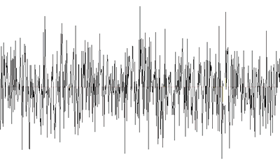
The Local Reparameterization Trick
Kingma, Salimans, and W. "Variational dropout and the local reparameterization trick”
Parts
Objects
Edges
Introduce noise to weights
Pixels
Output
Dog?
Cat?
Noise propagates to activations
Notes:
Bayesian deep learning is a key focus area for us and addresses many of these deep learning challenges
Bayesian deep learning is stochastic, meaning that we add noise or random values to the weights of the neural network
[click]
In the diagram, the added noise is visualized as the shaking of each weight parameter. The shaking weights propagates noise to the activation nodes.
[click]
This noise is a good thing and is actually inspired by how the brain works. One benefit of this Bayesian deep learning is compression and quantization, which is the focus of this talk. Compression and quantization
Reduce complexity of neural network model
Reduce bit-width of parameters and activations
Save power and improve efficiency

Slide 26
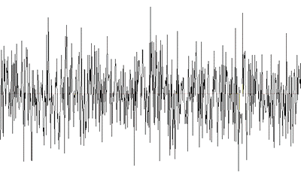
w₁
Initial weight values
Introduce noise to parameters
Prior P(W)—distribution before data (X)
Posterior P(W|X,Y)—distribution after data
Apply Bayesian deep-learning to model compression
Quantize weights: Use lower precision (bit-width)
Prune activations: Reduce number of activation nodes
w₁ is pinned down
w₂
w₂ is still highly uncertain
Parts
Objects
Quantize weights (or even remove)
Edges
w₁
Pixels
w₂
Output (Y)
Dog
Cat
Add data (X)
X
Prune activations (similar method as quantization)
Notes:
Let’s walk through a simple example to provide intuition about how Bayesian deep learning can be applied to shrink the model.
There is an individual weight value for each line of the neural network, all part of a matrix W. Let’s consider just 2 of the weights, w1 and w2.
There are initial weight values for w1 and w2 at the gray dot.
[CLICK]
We then introduce noise to the parameters, which gives us multiple potential points for w1 and w2, the green points, that make up the distribution before data.
[CLICK]
We then add data, which gives us the posterior distribution after data. The green dots have all shifted to the blue distribution.
[CLICK]
You’ll notice that w1 is pinned down and confined to a very narrow range, making it certain. However, w2 is highly uncertain, which means that it is not very useful
[CLICK}
This means that we can either quantize the weights (represent them with less bits) or completely remove the weight.
{CLICK]
In a similar method as quantizing a weight, which I won’t get into now, you can also prune entire activation nodes.
The point of all this is that we are shrinking the model, so that we need to do less work on each inference, which ultimately saves power.

Slide 27
Some Recent Methods based on Probabilistic Deep Learning

Slide 28
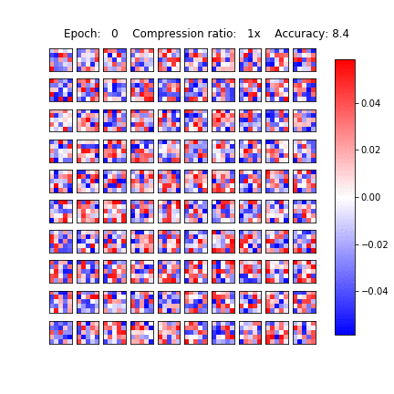
Bayesian Compression
CNN filters
(dropout posterior)
Animation: Molchanov, D., Ashukha, A. and Vetrov, D.

Slide 29
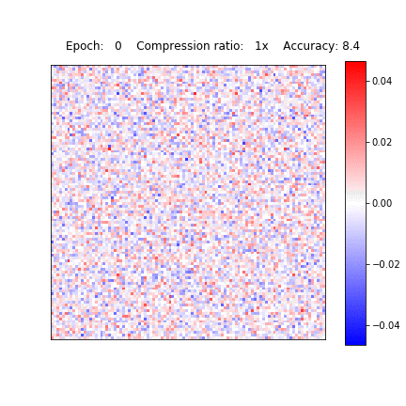
Bayesian Compression
Fully connected layer
(dropout posterior)
Animation: Molchanov, D., Ashukha, A. and Vetrov, D.

Slide 30
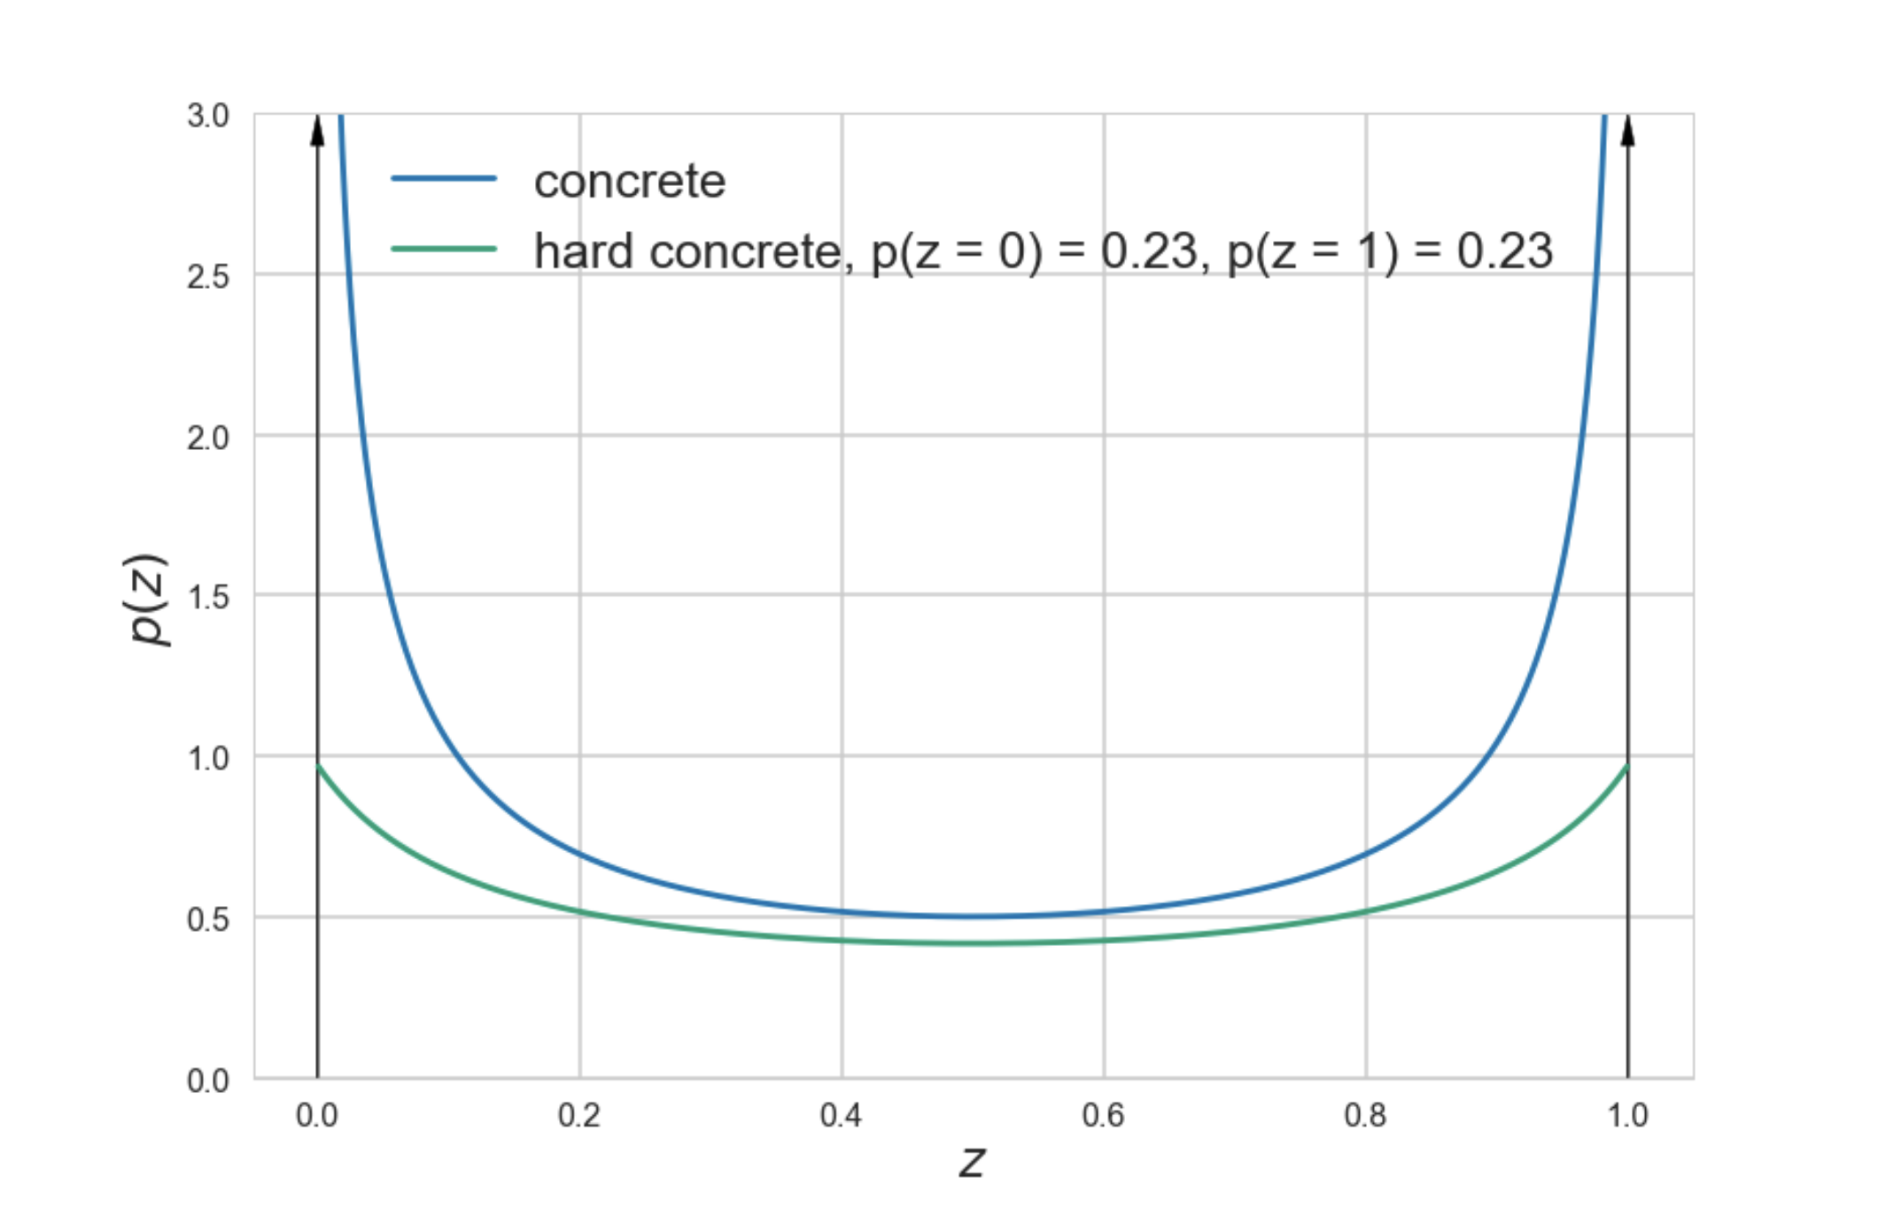
Network Pruning
“Learning Sparse Neural Networks through L₀ Regularization”, 2018, Louizos, W. & Kingma
AMLAB & OpenAI
g() restricts ’s’ to domain [0,1]
Probability for g(s) so be non-zero

Slide 31
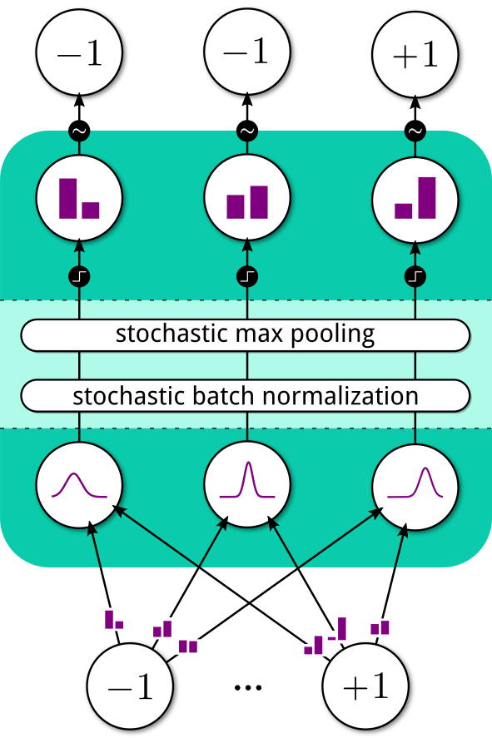
Probabilistic Binary Networks
Discrete activations
Sample
“Probabilistic Binary Neural Networks”, 2018, Peters & W.
(Bosch-UvA Delta Lab)
Binomial distributed activations
Thresholding
Probabilistic versions of BN & MP
Gaussian pre-activations
Binomial distributed binary weights
Binary activations

Slide 32
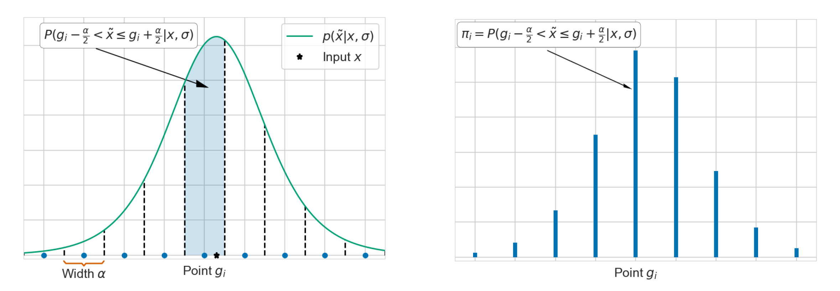
Differentiable Quantization
“Differentiable Neural Network Quantization”, 2018, Louizos, Reisser, Blankevoort, W.
(Qualcomm AI Research & QUVA)
Define differentiable distribution over grid points
Use Gumbel-Softmax to sample gridpoint
Backprop to learn weights, grid-values
Imagenet Top1 Error | High Precision | Rounding | DNNQ (this work)
Mobilenet | 28.36% | 5/5: 55.23% | 5/5: 42.77%
Resnet18 | 30.46% | 4/4: 78.79% | 4/4: 37.54%

Slide 33
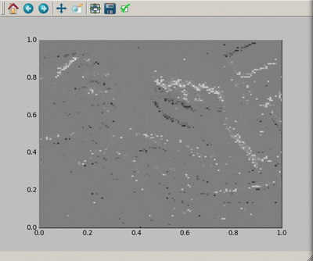
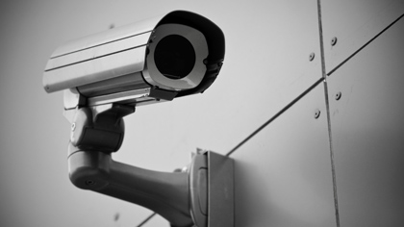
Spiking Neural Networks
O’ Connor, Gavves & W., 2018, “Temporally Efficient Deep Learning with Spikes”
99.9% of the time the image doesn’t change.
We only want to process/analyze changes
https://studywolf.wordpress.com/tag/spiking-camera/
(Jorg Conradt)

Slide 34
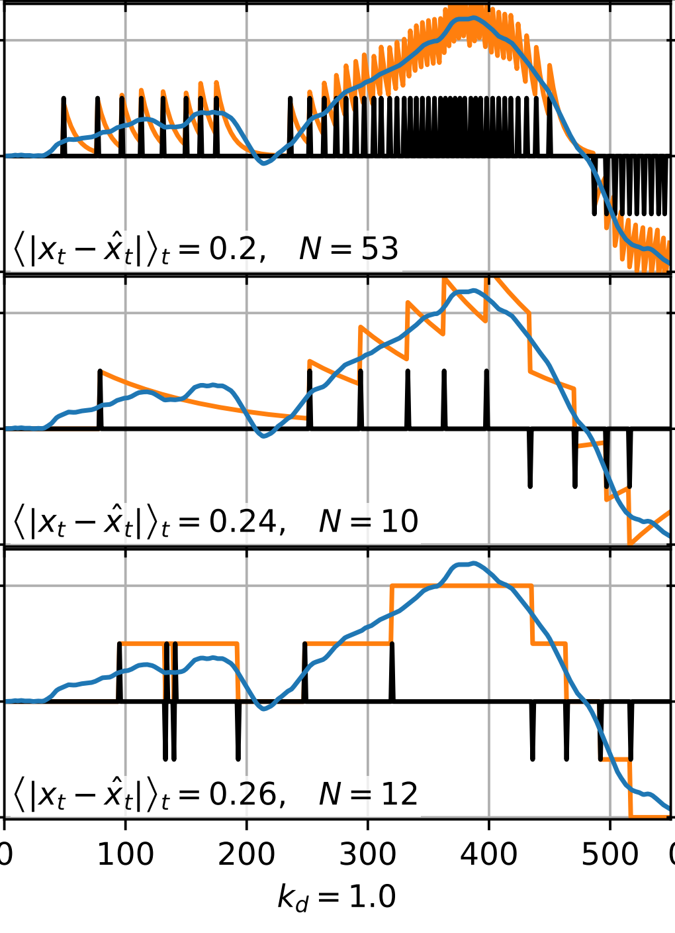
Spiking Neural Networks
O’ Connor, Gavves & W., 2018, “Temporally Efficient Deep Learning with Spikes”
signal
Invert the encoder
Linear combination of current signal and difference with previous
signal
K_{p} = 0.1
approximated signal
Spiking signal
K_{p} = 0.01
K_{p} > 0 needed for stable backpropagation
Send a ”spike” when sufficient
signal has accumulated.
= sigma-delta modulation / herding
K_{p} = 0

Slide 35
Epilogue Discussion and Conclusions

Slide 36
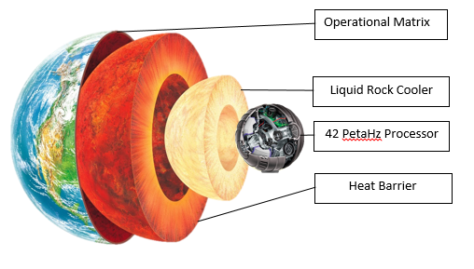
The Ultimate Question of Life, the Universe, and Everything
Black holes are made of bits
From: The Hitchhiker’s Guide to the Galaxy
Gravity is entropy maximization

Slide 37
Free Energy
Entropy can improve computational efficiency
Helmholtz:
F=E-H
Physics
Hinton:
Variational Bayes
Jaynes:
Entropy is ignorance
Rissanen:
MDL
Modeling

Slide 38
Bayesian deep learning provides broad benefits
A powerful tool to address a variety of deep learning challenges
Compression and quantization
Quantize parameters and activations, prune model components
Regularization and generalization
Avoid overfitting data; choose the simplest model to explain observations (Occam’s razor)
Confidence estimation
Generate the confidence intervals of the predictions
Privacy/adversarial robustness
Avoid storing personal information in parameters, be less sensitive to adversarial attacks
Notes:
Bayesian deep learning provides more benefits than just compression and quantization. I do not have time to cover the rest of these in detail, but they are all very valuable.
Regularization and generalization
Avoid overfitting data; choose the simplest model to explain observations (Occam’s razor)
Aggregate predictions from different models weighted by their explanatory power (Bayes)
Confidence estimate
Generate the probability distribution of the predictions.
Improve trust in model prediction by knowing when it is highly confident or uncertain.
Privacy and adversarial robustness
Learn robustly without personal data being shared.
Be less sensitive to small adversarial changes to the input.

Slide 39
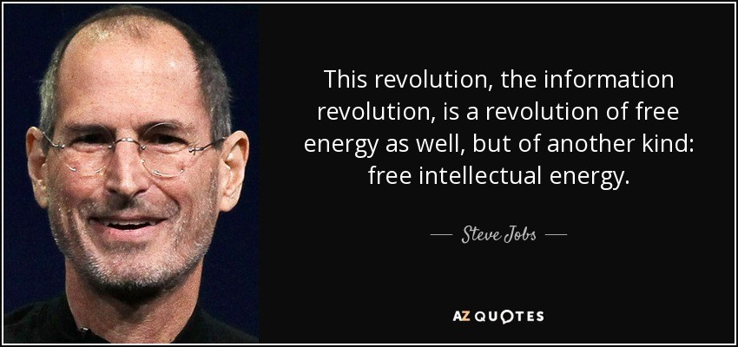
Think Deep, Think Free

Slide 40
(Yes, we are hiring)

Slide 41
Full Professor Machine Learning AMLAB
http://www.uva.nl/en/content/vacancies/2018/07/18-393-chair-in-machine-learning-full-or-associate-professor.html

Slide 42
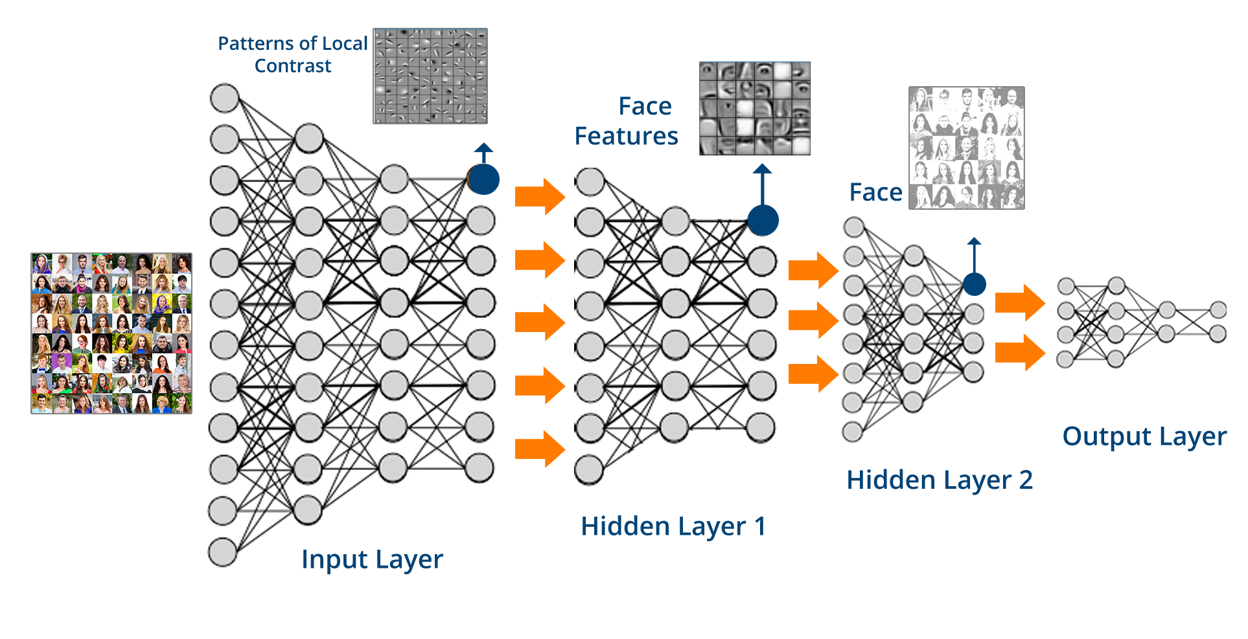
Questions?
This is Slide 42, (42 points Calibri Light) (the answer to the Ultimate Question of Life, the Universe and Everything)
(the answer is 42)
“Deep Thought”

